Slide 1
Cryptocurrency
Sentiment & Trading Analysis
Nick Baronti, Jeri LaCson, Ryan Keen, & Tina Calvin
February 26, 2022

Slide 2



AGENDA
1. Project Objectives
2. Updated Data Extraction (Binance)
3. Data Manipulation & Cleanup
4. NLTK Sentiment Analysis
5. Crypto Entry/Exit Point Analysis
6. Packages Used

Slide 3
Project OBJECTIVES
Update API to extract historical crypto prices from Binance US exchange.
Refresh crypto portfolio dashboard with latest prices (hourly).
Extract most relevant news articles for each crypto using the News API.
Analyze sentiment of each crypto in portfolio using NLTK.
Create crypto entry & exit point charts for all cryptos.

Slide 4

CCXT LIBRARY:
CryptoCurrency eXchange Trading library
The CCXT library is used to connect and trade with cryptocurrency exchanges and payment processing services worldwide.
It provides quick access to market data for storage, analysis, visualizations and algorithmic trading.
Binance US API:
Used the Binance US exchange API to extract Open, High, Low, Close, Volume (OHLCV) historical crypto data for the last 1,000 hours.
Extracted hourly data for more precise entry & exit point analysis.
https://github.com/binance-us/binance-official-api-docs
Data extraction
(API)

Slide 5

OHLCV HISTORICAL DATA:
  Used for loop to loop through list of top 50 cryptocurrencies and extract OHLCV data using CCXT & Binance
  Used try & except to determine base currency denomination (i.e., BUSD, USDT, USDC, UST) for each cryptocurrency
  Used TQDM function to show a progress bar loading crypto data
  Appended crypto price data to a list and then converted into Pandas dataframe
CUSTOM ALTCOIN PORTFOLIO:
  Created custom portfolio of altcoins selecting 6 of the top 50 cryptocurrencies (non-bitcoin)
  Established variables for initial total investment, portfolio weights, & number of days invested
  Created function to determine the units invested in each crypto as of the initial investment date
  Created custom Pandas dataframes of portfolio data to use for interactive charts, plots, and Monte Carlo simulations
Data manipulation & cleanup

Slide 6

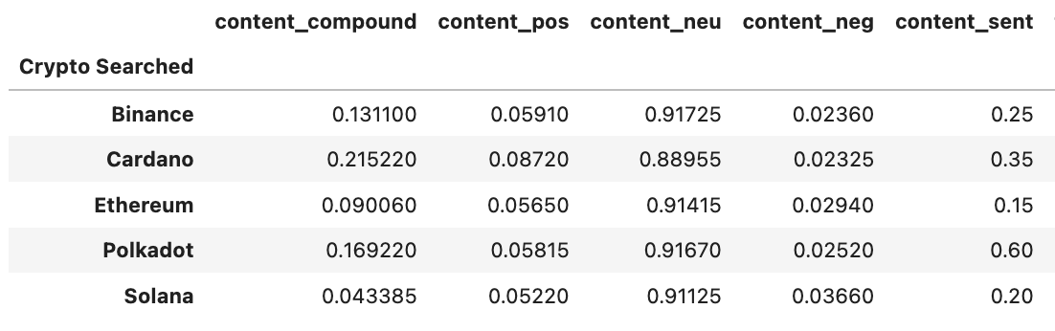
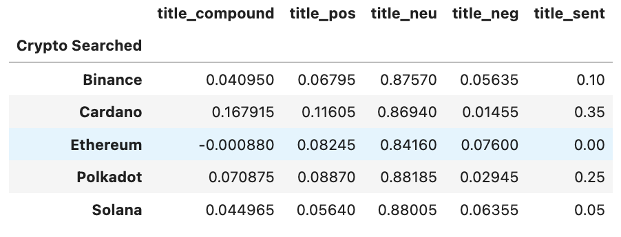
VADER SENTIMENT ANAYSIS:
  Used Vader Lexicon Sentiment Intensity Analyzer
  Polkadot (DOT) scored the highest in terms of content score.
  Cardano (ADA) scored the highest in terms of title score.
  Ethereum (ETH) scored the lowest in terms of content score and title score.
NLTK Sentiment Analysis

Slide 7

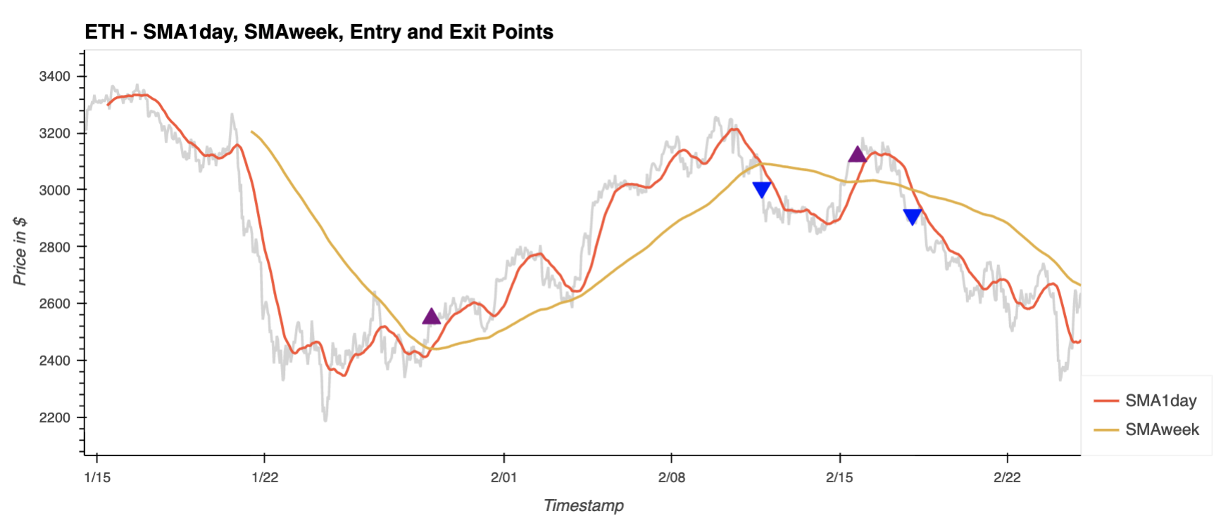
CRYPTO SMA CHART ANALYSIS:
  Created DataFrame for each crypto with 1-day and 1-week simple moving average (SMA) calculations.
  Created algorithm to track entry & exit points for each cryptocurrency based on the two SMAs crossing each other.
  1-day SMA > 1-week SMA = Bullish (Enter)
  1-day SMA < 1-week SMA = Bearish (Exit)
Crypto Entry/Exit
Point
Analysis

Slide 8

CRYPTO ENTRY/EXIT POINT CHARTS USING ALGORITHM BASED ON 1-day SMA &
1-Week SMA.

Slide 9
ETH Entry & Exit Point Chart

Slide 10
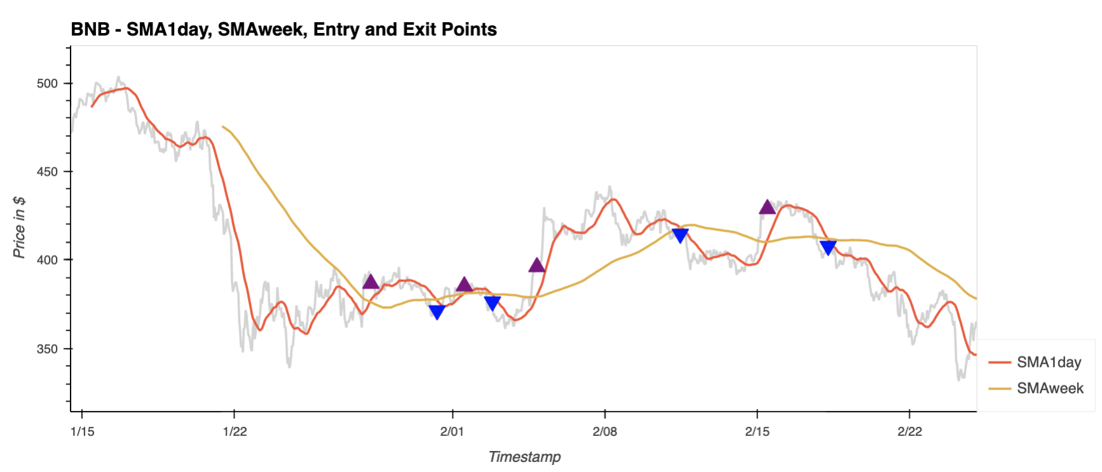
BNB Entry & Exit Point Chart

Slide 11
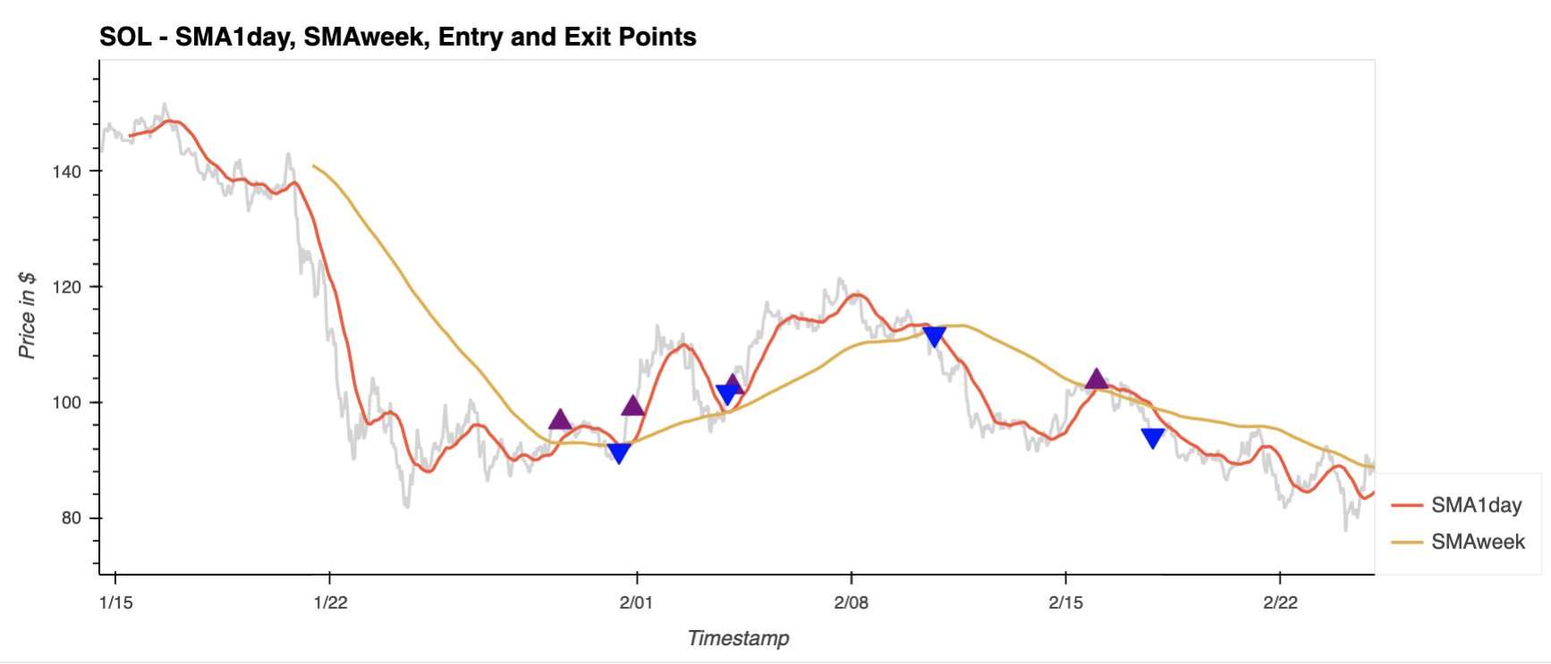
SOL Entry & Exit Point Chart

Slide 12
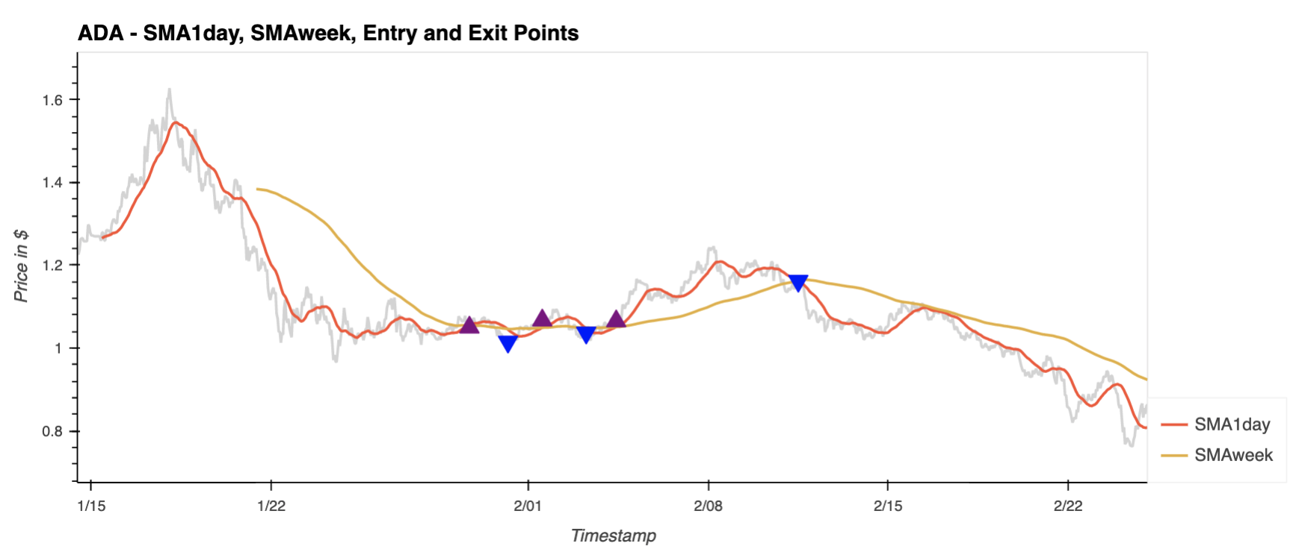
ADA Entry & Exit Point Chart

Slide 13
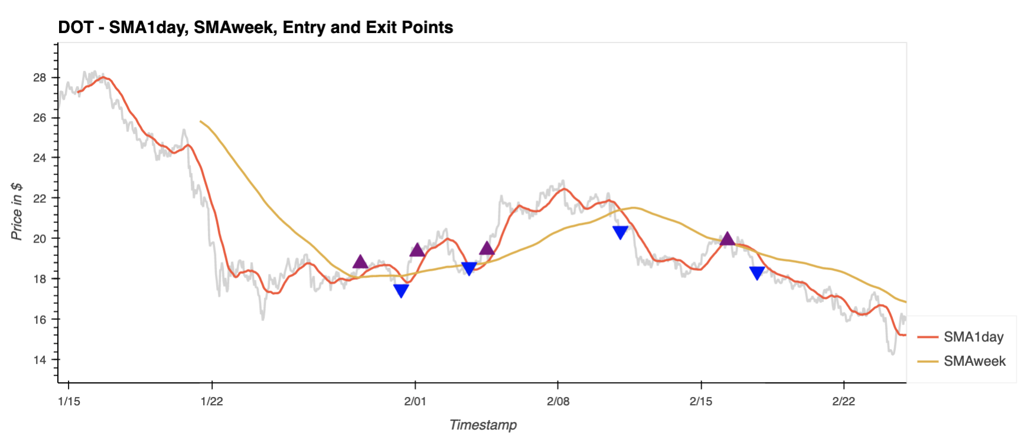
DOT Entry & Exit Point Chart

Slide 14
Data & Calculations | APIs | Packages
1. Data extraction via Binance US exchange (using CCXT) | Binance US API | Numpy, Pandas, TQDM, Hvplot, Matplotlib
2. Sentiment Analysis on 6 cryptos within portfolio dashboard | News API | NLTK, JSON, Pandas
3. Pick top 3 best sentiment scores (compound score on article & title) | N/A | NLTK, Pandas
4. Build entry & exit point chart analysis for each of the 6 cryptos within the portfolio dashboard | N/A | Custom functions, Hvplot

